Slide 1
SPARK RDD

Slide 2
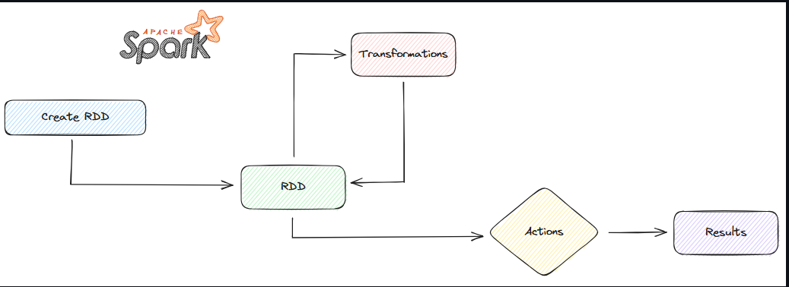

Slide 3
Architecture of RDD
Create RDD (Resilient Distributed Datasets): The first step is to create RDDs, which are distributed data structures that can be divided and distributed across the computers in the Spark cluster. RDDs can be created from various sources, such as program variables, other RDDs, or external data sources like files.
Transformation: After creating RDDs, we can apply Transformations to change the data within the RDDs using functions like map, flatMap, filter, and others. The result of a Transformation is a new RDD with the transformed data.
RDD: After performing Transformations, we obtain new RDDs that have undergone the specified changes. These RDDs hold distributed data within the Spark cluster.
Actions: Actions are steps where we actually perform operations on the data within RDDs. This includes actions such as collecting data (collect), counting elements (count), calculating sums (sum), finding maximum values (max), and others.
Results: The results represent the outcomes of the Actions performed on the data. These results can be numeric values, lists of data, or the results of various computations derived from data processing.

Slide 4
What is an RDD?
RDD (Resilient Distributed Dataset) is the fundamental data structure in Apache Spark. It represents an immutable, distributed collection of objects that can be processed in parallel across a cluster.
In short:
RDD = A fault-tolerant, distributed, in-memory collection of data elements.
Resilient: If a partition of an RDD is lost, it can be recomputed using the original transformations (lineage).
Distributed: RDDs are automatically distributed across nodes for scalability and fault tolerance.
Immutable: Once an RDD is created, it cannot be changed. Transformations return new RDDs.
Lazy Evaluation: Spark builds a lineage graph of transformations and only executes them when an action is called.

Slide 5
🧩 2. Key Features of RDD
Feature | Description
Resilient | Fault-tolerant — Spark can recompute lost data using lineage (a record of transformations).
Distributed | Data is split across cluster nodes (partitions).
Immutable | Once created, it cannot be modified — new RDDs are made via transformations.
Lazy Evaluation | Transformations are not executed immediately; Spark builds a DAG and runs it only when an action is called.
In-Memory Computation | Data can be cached in memory for faster reuse (important for iterative ML algorithms).

Slide 6
RDD Creation Methods
a) From Existing Collections
You can create an RDD from a Python list (local collection):
rdd = spark.sparkContext.parallelize([1, 2, 3, 4, 5])
b) From External Data Sources
Load data from files, HDFS, S3, etc.:
rdd = spark.sparkContext.textFile("data/input.txt")
c)From Other RDDs
Transform an existing RDD to create a new one:
rdd2 = rdd.map(lambda x: x * 2)

Slide 7
RDD Operations
RDDs support two types of operations:
Type | Description | Example
Transformations | Create a new RDD from an existing one (lazy). | map(), filter(), flatMap(), union(), join()
Actions | Trigger computation and return results. | collect(), count(), saveAsTextFile(), first(), reduce()

Slide 8
RDD Transformations & Lineage
Spark Transformation is a function that produces new RDD from the existing RDDs.
It takes RDD as input and produces one or more RDD as output.
Each time it creates new RDD when we apply any transformation. Thus, the so input RDDs, cannot be changed since RDD are immutable in nature.
Applying transformation built an RDD lineage, with the entire parent RDDs of the final RDD(s).
RDD lineage, also known as RDD operator graph or RDD dependency graph.
It is a logical execution plan i.e., it is Directed Acyclic Graph (DAG) of the entire parent RDDs of RDD.
Transformations are lazy in nature i.e., they get execute when we call an action. They are not executed immediately. Two most basic type of transformations is a map(), filter().

Slide 9
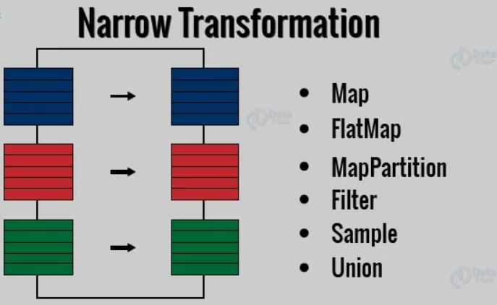
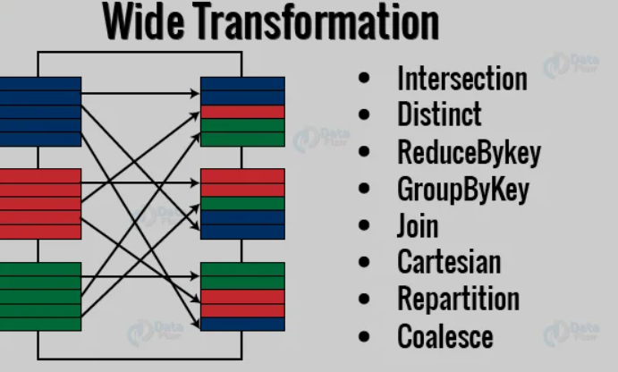
Narrow & Wide Transformations
Narrow transformations:
These transformations don't require shuffling data between partitions. All data needed for a new partition resides within a single parent partition.
Wide transformations:
These operations require shuffling data across partitions over the network, making them more expensive.

Slide 10
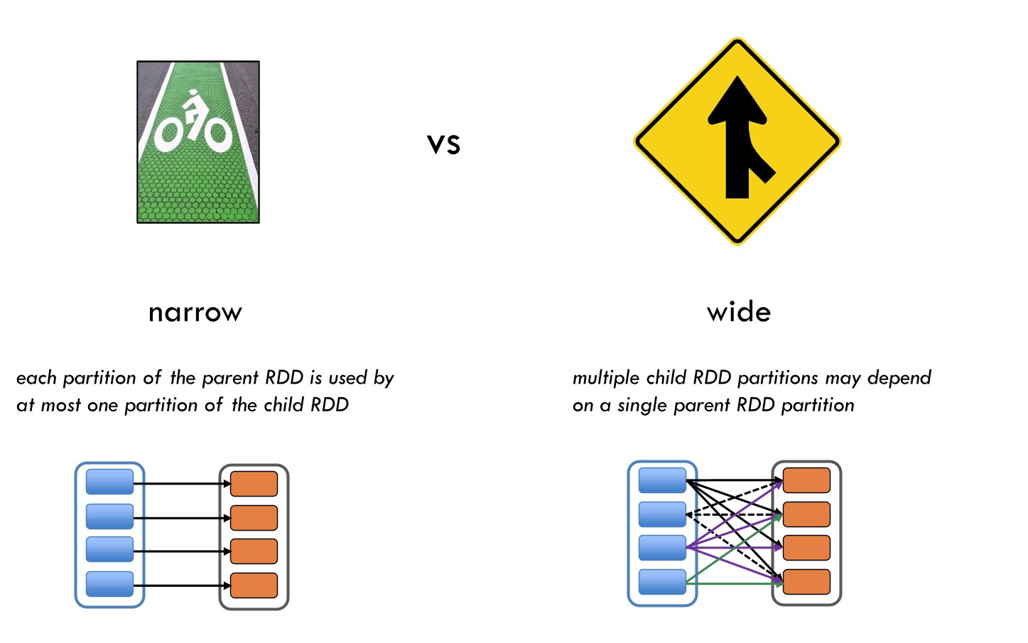

Slide 11
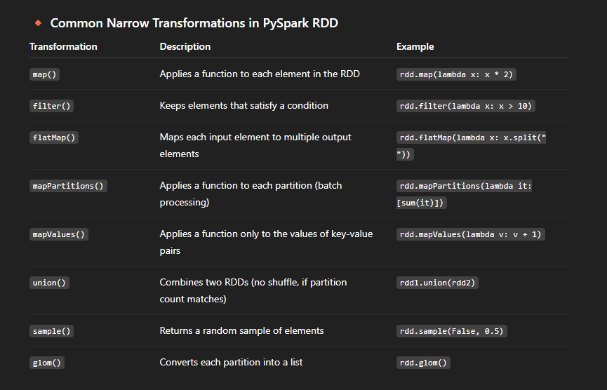

Slide 12
Narrow
map() : The map() function applies a given function to each element in an RDD or DataFrame, without requiring any data exchange between partitions.
filter() : The filter() transformation retains elements that satisfy a certain condition, processing each partition individually.
flatMap(): Similar to map(), but flatMap() allows each input element to produce zero, one, or multiple output elements, still operating within each partition independently.

Slide 13
Wide Transformations
Transformation | Description | Example
groupByKey() | Groups values with the same key across partitions (causes shuffle). | rdd.groupByKey()
reduceByKey() | Combines values with the same key using a reduce function. More efficient than groupByKey(). | rdd.reduceByKey(lambda x, y: x + y)
aggregateByKey() | Aggregates values for each key using separate functions for combining within and across partitions. | rdd.aggregateByKey(0, lambda x, y: x + y, lambda x, y: x + y)
join() | Joins two RDDs by key; requires shuffling of data. | rdd1.join(rdd2)
leftOuterJoin(), rightOuterJoin(), fullOuterJoin() | Outer joins that also cause data shuffling. | rdd1.leftOuterJoin(rdd2)
cogroup() | Groups data from multiple RDDs sharing the same key. | rdd1.cogroup(rdd2)
distinct() | Removes duplicate records — requires a shuffle to group identical records. | rdd.distinct()
repartition() | Rebalances the number of partitions by randomly redistributing data (always shuffles). | rdd.repartition(4)
sortByKey() | Sorts RDD by key across partitions. | rdd.sortByKey()
combineByKey() | Generalized version of reduceByKey allowing different input/output types. | rdd.combineByKey(...)

Slide 14
🧮 Common Actions
Operation | Description | Example
collect() | Return all elements to driver | rdd.collect()
count() | Count number of elements | rdd.count()
first() | Get first element | rdd.first()
take(n) | Get first n elements | rdd.take(3)
reduce() | Aggregate using function | rdd.reduce(lambda a,b: a+b)
saveAsTextFile() | Save results to file | rdd.saveAsTextFile("output")

Slide 15
RDD Persistence (Caching & Checkpointing)
Caching
Used when you reuse the same RDD multiple times:
rdd.persist()
# or
rdd.cache()
Stores data in memory for faster access.
Checkpointing
Used for fault-tolerance and breaking long lineage chains:
sc.setCheckpointDir("hdfs://path/to/checkpoint/")
rdd.checkpoint()

Slide 16
Key-Value Pair RDDs
Special RDDs containing (key, value) pairs enable distributed operations like grouping and joins.
data = sc.parallelize([("a", 1), ("b", 2), ("a", 3)])
result = data.reduceByKey(lambda x, y: x + y)
print(result.collect())
# Output: [('a', 4), ('b', 2)]
Operation | Description
reduceByKey(func) | Aggregate values for each key
groupByKey() | Group values by key
mapValues(func) | Apply function to each value
join(otherRDD) | Join two key-value RDDs by key

Slide 17
RDDs excel when you need:
Fine-grained control over data distribution and processing
Custom transformations that don't map well to SQL-like operations
Machine learning algorithms that require iterative processing
Streaming data processing with complex event handling
DataFrames are better for:
Structured data with known schemas
SQL-like operations (filtering, grouping, joining)
Automatic optimizations for query performance
Integration with Spark SQL and MLlib

Slide 18
RDD vs Data Frame
Aspect | RDD | DataFrame
Abstraction Level | Low-level | High-level
Data Type | Objects | Structured (rows/columns)
Optimization | Manual | Automatic (Catalyst Optimizer)
Ease of Use | Complex | Simple API
Performance | Slower | Faster (optimized execution plan)
When to Use | Complex transformations, low-level control | SQL-style or structured operations

